Slide 1
Exploring factors contributing to railway crossing Accidents
Xiuzhu Gu and Atsutoshi Nakai
Department of Industrial Engineering and Economics
Tokyo Institute of Technology

Slide 2
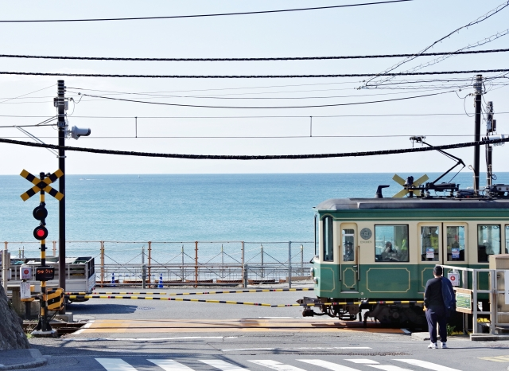
Introduction
Railway Crossing in Japan：Around 33000 in total
Railway Crossing by Kamakura-Koko-Mae Station
Railway crossing accidents
Train involved
Train uninvolved

Slide 3
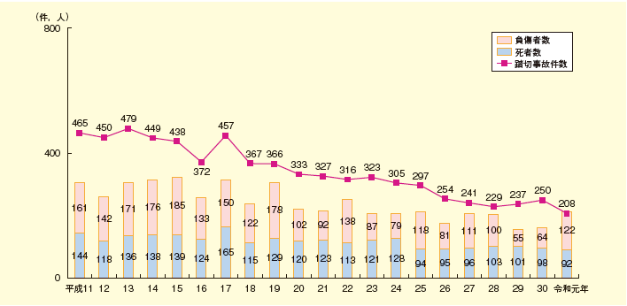
Background
Number of railway crossing accidents
Number of injured
Number of death
1999
2019
Ministry of Land, Infrastructure, Transport and Tourism, Japan
Objective
To explore the important factors that contribute to
railway crossing accidents.

Slide 4
Methods
Two sets of data were collected and analyzed
1479 railway crossing records
(Ministry of Land, Infrastructure, Transport and Tourism; 2016)
2. 61 railway crossing accident reports
(Japan Transport Safety Board; published from 2001 to 2020)

Slide 5
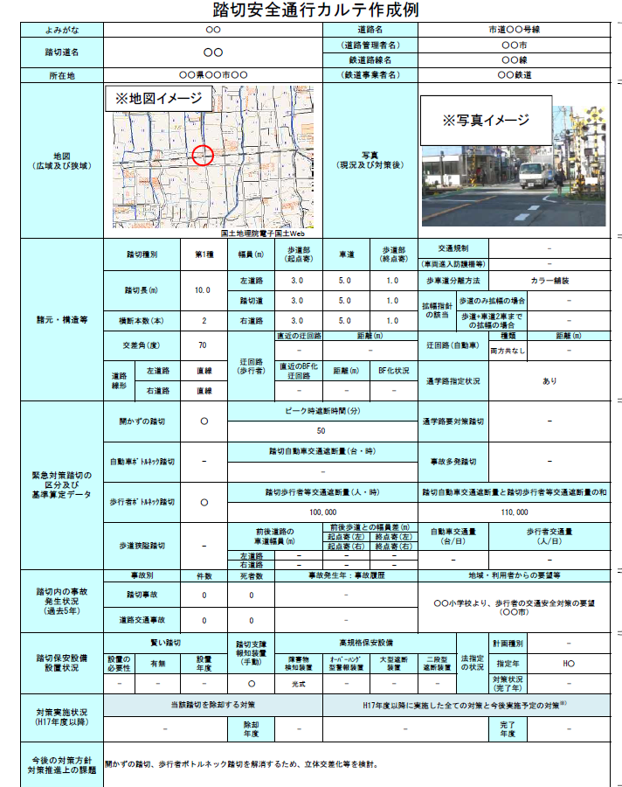
Methods
Railway crossing records
Characteristics of the crossing
Traffic volume
Number of accidents
(in the past five years)
Train involved
Train uninvolved

Slide 6
Methods
Definitions of binary variables (Yes or No)
Variables | Definition
Smart crossing | Crossings that can optimize the blocking time.
Hindrance notification device | A device that can notify hindrances near the railway crossings.
Vehicle bottleneck | Crossings that have 50,000 or more daily vehicle traffic blocking.
Pedestrian bottleneck | Crossings that the daily traffic blocking for vehicles and pedestrian is 50,000 or more, in which the amount for pedestrian blocking is 20,000 or more.

Slide 7
Methods
Definitions of continuous variables
Variables | Definition
Crossing length (m)
Number of crossing railway tracks
Intersection angle (°) | The angle of the center lines of the tracks and the road.
Blocking time in peak hours (min/h)
Amount of blocked vehicles (per day)
Amount of blocked pedestrians (per day)
Vehicle traffic volume (per day)
Pedestrian traffic volume (per day)

Slide 8
Results
Railway crossing records (binary variables)
***
***

Slide 9
Results
Railway crossing records (continuous variables)
Variables | Accident (NO) | Accident (YES)
Crossing length (m) | 11.80 | 12.53
Number of crossing railway tracks | 2.25 | 2.44
Intersection angle (°) | 75.48 | 75.30
Blocking time in peak hours (min/h) | 44.79 | 45.52
Amount of blocked vehicles (/day) | 61110 | 64525
Amount of blocked pedestrians (/day) | 54470 | 66739
Vehicle traffic volume (/day) | 5206 | 4779
Pedestrian traffic volume (/day) | 1474 | 2197
**
<
***
<
*
<
***
<

Slide 10
Methods
Railway crossing accident reports
Human Factors Analysis and Classification System (HFACS)
(Wiegmann and Shappell; 2003)
J-HAFCS (Nakamura et al., 2012)
Unsafe acts
Errors
Violations
Environmental factors
Conditions of others
Unsafe supervision
Inadequate supervision
Planned inadequate operations
Organizational influences
Failed to correct problem
Preconditions
Conditions of train drivers
Resource management
Organizational climate
Organizational process
Supervisory violations

Slide 11
Results
Railway crossing accident reports (unsafe acts)

Slide 12
Results
Railway crossing accident reports (preconditions)

Slide 13
Results
Railway crossing accident reports
(unsafe supervision)

Slide 14
Results
Railway crossing accident reports
(organizational influences)

Slide 15
Discussion
Characteristics of crossings
Smart crossings More accidents (?)
Pedestrians >> Vehicles
Vehicle drivers
Routine violations etc.
Elderly people (super-ageing society)
Perception errors
Decrease in attention etc.
Insufficient safety awareness
Human-related factors

Slide 16
Implications
Taking measures to pedestrian bottleneck crossings
Improvement of crossing environment management
Taking measures to support safety risky people
Improvement of organizational safety climate
Safety education to public (pedestrians, vehicle drivers)

Slide 17
Conclusions
Crossing factors contributing to accidents
Smart crossing
Crossing length; Number of crossing railway tracks
Pedestrian bottleneck
Amount of blocked pedestrians
Pedestrian traffic volume

Slide 18
Conclusions
Unsafe acts (pedestrians; vehicle drivers)
Perception errors
routine violations
Preconditions
Environmental factors
Substandard conditions of pedestrians and vehicle drivers
Unsafe supervision
Inappropriate risk assessment
Untreated crossing environment issues
Lack of safety information publicity
Organizational influences
Organizational climate
Inappropriate business management

Slide 19
Thank you for your attention!

